Slide 1

AIS – Security Options
Do we know the security options available to make AIS good enough for various security compliance requirements? Lets have a look at them, shall we?

Slide 2
Presenters
Vinnie James
Solution Architect, Datacom

Slide 3
“Passwords are like underwear: make them personal, make them exotic, and change them on a regular basis.” — overheard at SecureWorld Atlanta
Notes:
What is Multi-Factor authentication?
When I first started implementing my first Azure project for a public sector, Security architect asked me what’s multi factor authentication in the hope of teaching a project manager from my answers? I was alarmed and my funny face went up trying to hide my panicked face. I seriously didn’t know how to explain, I just emphasized on the word “multi” translates to many- To my relief he turned to the manager, that’s right, its authentication via more than one factor. That’s how i started my azure journey with public sector. Later in the project We ended up setting up SSO and mfa for Elastic search solution using Azure AD. So many other security controls we decided to implement and other things unearthed by the penetration testing. i am sure this is not a new scenario for most of us integration developers. when we hear security classifications (restricted, classified) and security compliance’s like PCI, as an integration developer we distance ourselves. no it’s not us. unfortunately it’s not anymore. Since integration is becoming the center of everything, security compliance’s and the level of restrictions on integration implementation is also getting a huge focus.

Slide 4
What’s AIS?
APIM
Logic Apps
Event Grid
Service Bus
Or is it ALES ☺
Notes:
I remember the time when MuleSoft was targeting BizTalk and establishing a good customer base, there was no appropriate product available from Microsoft to counter the cloud presence and a complete story provided by MuleSoft. Then Azure BizTalk services came, not quite filled the gap. Logic apps initial versions worked ok but not a complete story for an Integration platform. Slowly when these four products were used combine, it started showing a united front to complete a cloud based integration capability.
APIM – API lifecycle, Security, Developer engagement
Logic Apps – Build easy workflow with readily available connectors
Service Bus – A message broker to simulate / reproduce our good old BizTalk message box
Event Grid – To facilitate the raising event trigger phenomenon.

Slide 5
Security Options at APIM
Authorization Key – An unique key to identify a subscription to the APIs
Secure the Back End API using OAuth2/JWT - each client application request header must contain a valid OAuth2 JWT token – otherwise a 401 Unauthorized will be returned.
Client Certificate - An APIM policy can be configured comparing an incoming client certificate against a certificate uploaded to APIM.
APIM to Back End API Mutual Certification - TLS mutual authentication, or client certificate authentication, can be set up for Azure based Web Apps or API Apps.
Notes:
Authorization Key - every request made to an APIM operation must include an Ocp-Apim-Subscription-Key in the request header. This is assuming that the product it is linked to is configured as protected and requires a subscription. The key identifies the developer APIM subscription and can be found and managed in the Developer Portal. As best practice, it should be regenerated as part of a password rotation policy.
Secure the Back End API using OAuth2/JWT - The Web client must first obtain an expiring JWT access token from the AS. If your back end API implements OAuth2, then you can additionally implement an APIM policy expression which requires that a JWT token be supplied by the client application in the request header. JWT validation policy expressions can actually be very granular. Eg: a policy expression can check that a client application http post request header includes a particular JWT token containing a matching claim.
Client Certificate - Within the APIM policy a context object is available that gives access to both incoming certificates and any certificates stored in APIM. We can now check for an incoming certificate, but how does the client developer include a certificate in a client request? Answer: Install a certificate on the client machine and load it up in the request from code.
APIM to Back End API Mutual Certification - This does not work over HTTP, as it requires HTTPS, hence a certificate must be installed on both the Web App and APIM.

Slide 6
Security Options at APIM - Contd
IP Address White-list the APIM in Azure back end API– As the APIM has a static IP Address, the Azure BEAPI can white-list only the APIM. Hence, the Azure back end API will reject all calls - except those from the APIM IP address.
IP Address White-list the client in APIM by policy – Add a policy to whitelist or blacklist certain list of IPs to allow or prevent access to the backend API
APIM Under VNET on Internal / External mode - Configuring a VNET for APIM to access on premise Backend API. Using a VNET avoids having to expose an on premise backend API to the public internet.
Configuring APIM RBAC- control which users in your organisation have access to APIM and what they can do.
Users/Groups/Products - A published product grants visibility to Groups. A User must be a member of a Group. Users and Groups can be created manually or may originate from a local AAD or partner AAD.

Slide 7
Security Options at APIM-Contd
Access to Developer Portal from Identity Providers– Access to the Developer Portal can be granted to users via a selection of identity providers.
HTTPS – All traffic should be encrypted in transit using HTTPS. This requires a certificate at each Application node
Policy- Configuring multiple products across APIs to enforce individual rates, quotas and custom security through APIM policy.
Logging all requests that reach APIM into Azure Event Hub - APIM does provide a fully comprehensive audit of all requests that are received, but only a subset.
Managed Identity- APIM to access secure properties from Keyvault, it can access via Managed Identity
Named Values: Some sensitive properties or values can be stored in Named Values and accessed directly from policies
Notes:
Access to Developer Portal from Identity Providers - This can include accounts in local or partner Azure AD, or social media accounts.
Logging all requests that reach APIM into Azure Event Hub - If full audit or miscellaneous trace details are required then APIM can be configured to forward these details to a logger. For performance reasons the logger typically publishes to an Azure Event Hub. Subscribers of the Event Hub can be set up. These could include technologies such as: Azure Table Storage, Stream Analytics, PowerBI and Azure Machine Learning.

Slide 8
Security Options at APIM-Contd
There’s a couple of common questions that organisations have with API Management :
How do we protect the Internet-facing public endpoint of API Management?
How can we selectively expose some API’s externally whilst keeping all other API’s internal?
Answer to the first question alone – Front Door
An Azure component that solves both the problems:
Application Gateway

Slide 9
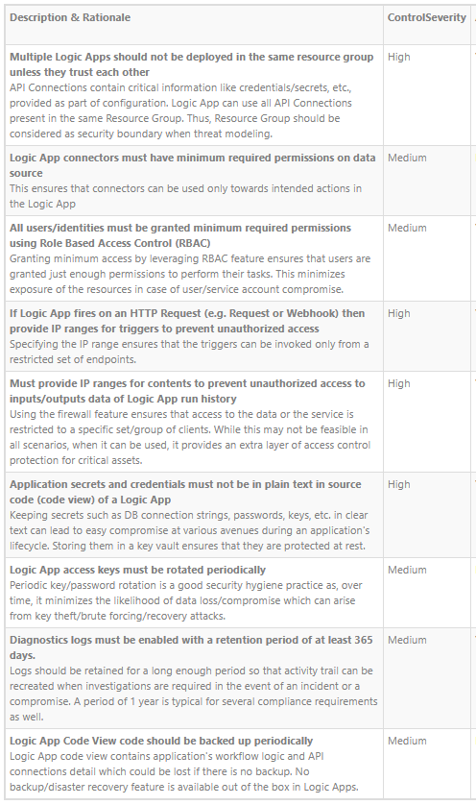
Security Controls: Logic Apps
Notes:
ISE - An ISE is an isolated environment that uses dedicated storage and other resources that are kept separate from the public, "global", multi-tenant Logic Apps service. This separation also reduces any impact that other Azure tenants might have on your apps' performance. When you create an ISE, Azure injects that ISE into your Azure virtual network, which then deploys the Logic Apps service into your virtual network.

Slide 10
Security Options at–Logic Apps
ISE - For scenarios where your logic apps and integration accounts need access to an Azure virtual network, create an integration service environment (ISE).
Your logic app or integration account can then directly access resources, such as virtual machines (VMs), servers, systems, and services, in your virtual network.
It prevents the artifacts of your Integration account from public access (schemas, maps agreements)
Easy and secure access to on-premise resources
Private static outbound IPs
Custom inbound domain names
Notes:
ISE - An ISE is an isolated environment that uses dedicated storage and other resources that are kept separate from the public, "global", multi-tenant Logic Apps service. This separation also reduces any impact that other Azure tenants might have on your apps' performance. When you create an ISE, Azure injects that ISE into your Azure virtual network, which then deploys the Logic Apps service into your virtual network.

Slide 11
Security Options at–Logic Apps-Contd
Access to request-based triggers - limit access so that only authorized clients can call your logic app
Generate shared access signatures-Every request endpoint on a logic app has a Shared Access Signature (SAS) in the endpoint's URL
Restrict inbound IP addresses - you might want to specifically limit the clients that can call your logic app.
Add Azure Active Directory OAuth or other security – Logic apps can be exposed using API management and take advantages all security options available at APIM
Notes:
Restrict inbound IP addresses - you might want to specifically limit the clients that can call your logic app. For example, if you manage your request endpoint by using Azure API Management, you can restrict your logic app to accept requests only from the IP address for the API Management instance.
Add Azure Active Directory OAuth or other security - To add more authorization protocols to your logic app, consider using the Azure API Management service. This service helps you expose your logic app as an API and offers rich monitoring, security, policy, and documentation for any endpoint. API Management can expose a public or private endpoint for your logic app.

Slide 12
Security Options at–Logic Apps-Contd
Access to logic app operations - You can permit only specific users or groups to run specific tasks, such as managing, editing, and viewing logic apps by using RBAC rules.
Logic App Contributor: Lets you manage logic apps, but you can't change access to them.
Logic App Operator: Lets you read, enable, and disable logic apps, but you can't edit or update them.
Azure Resource Lock - To prevent others from changing or deleting your logic app
During a logic app run, all the data is encrypted during transit by using Transport Layer Security (TLS) and at rest.

Slide 13
Security Options at–Logic Apps-Contd
Access to run history data - To control access to the inputs and outputs in your logic app's run history, actions that handle any passwords, secrets, keys, or other sensitive information, you want to prevent others from viewing and accessing that data
Restrict access by IP address range - This option helps you secure access to run history based on the requests from a specific IP address range.
Hide data from run history by using obfuscation - In many triggers and actions, you can hide their inputs, outputs, or both from a logic app's run history.
Secure Input and Outputs – You can secure the inputs and outputs from the run history by explicitly declaring it

Slide 14
Security Options at–Logic Apps-Contd
Access to parameter data - define the parameters by using the securestring or secureobject type and use encoding as necessary.
Secure parameters in workflow definitions - In the workflow definition, the parameters section define the sensitive parameters by using the securestring type.
Secure parameters in Azure Resource Manager templates - To protect passwords, keys, secrets, and other sensitive information, define secured parameters at the template level and workflow definition level by using the securestring or secureobject type.
KeyVault - You can then store these values in Azure Key Vault and use the parameter file to reference the key vault and secret.
Managed Identities – List of Azure services can be accessed from Logic apps using managed identities. This eliminates the need to store credentials anywhere

Slide 15
Security Options at–Event Grid
WebHook Event delivery - Event Grid supports two ways of validating the subscription.
ValidationCode handshake (programmatic) - Your application verifies that the validation request is for an expected event subscription, and echoes the validation code to Event Grid
ValidationURL handshake (manual): Event Grid sends a validation Url property in the data portion of the subscription validation event. To complete the handshake, find that URL in the event data and manually send a GET request to it. You can use either a REST client or your web browser.
Notes:
Webhooks are one of the many ways to receive events from Azure Event Grid. When a new event is ready, Event Grid service POSTs an HTTP request to the configured endpoint with the event in the request body.
Like many other services that support webhooks, Event Grid requires you to prove ownership of your Webhook endpoint before it starts delivering events to that endpoint. This requirement prevents a malicious user from flooding your endpoint with events. When you use any of the three Azure services listed below, the Azure infrastructure automatically handles this validation:
Azure Logic Apps with Event Grid Connector
Azure Automation via webhook
Azure Functions with Event Grid Trigger

Slide 16
Security Options at–Event Grid-Contd
Event delivery security
Azure AD - You can secure your webhook endpoint by using Azure Active Directory to authenticate and authorize Event Grid to publish events to your endpoints.
Query parameters - You can secure your webhook endpoint by adding query parameters to the webhook URL when creating an Event Subscription.
Event Subscription - To subscribe to an event, you must prove that you have access to the event source and handler.
Notes:
Azure AD
You can secure your webhook endpoint by using Azure Active Directory to authenticate and authorize Event Grid to publish events to your endpoints. You will need to create an Azure Active Directory Application, create a role and service principle in your application authorizing Event Grid, and configure the event subscription to use the Azure AD Application.
Query parameters
You can secure your webhook endpoint by adding query parameters to the webhook URL when creating an Event Subscription. Set one of these query parameters to be a secret such as an access token. The webhook can use the secret to recognize the event is coming from Event Grid with valid permissions. Event Grid will include these query parameters in every event delivery to the webhook.
Event subscription
To subscribe to an event, you must prove that you have access to the event source and handler. Proving that you own a WebHook was covered in the preceding section. If you're using an event handler that isn't a WebHook (such as an event hub or queue storage), you need write access to that resource. This permissions check prevents an unauthorized user from sending events to your resource.
You must have the Microsoft.EventGrid/EventSubscriptions/Write permission on the resource that is the event source. You need this permission because you're writing a new subscription at the scope of the resource. The required resource differs based on whether you're subscribing to a system topic or custom topic

Slide 17
Security Options at–Event Grid-Contd
Custom topic publishing - Custom topics use either Shared Access Signature (SAS) or key authentication.
Key Authentication - Key authentication is the simplest form of authentication. Use the format: aeg-sas-key: <your key>
SAS Token - SAS tokens for Event Grid include the resource, an expiration time, and a signature. The format of the SAS token is: r={resource}&e={expiration}&s={signature}.

Slide 18
Security Options at–Event Grid-Contd
Management Access Control - Azure Event Grid allows you to control the level of access given to different users to do various management operations such as list event subscriptions, create new ones, and generate keys. Event Grid uses Azure's role-based access control (RBAC).
Built in Roles
EventGrid EventSubscription Contributor: manage Event Grid subscription operations
EventGrid EventSubscription Reader: read Event Grid subscriptions
Custom Roles - If you need to specify permissions that are different than the built-in roles, you can create custom roles.

Slide 19
Security Options at–Event Grid-Contd
Encryption at rest
All events or data written to disk by the Event Grid service is encrypted by a Microsoft-managed key ensuring that it is encrypted at rest.
Additionally, the maximum period of time that events or data is retained is 24 hours in adherence with the Event Grid retry policy
Event Grid will automatically delete all events or data after 24 hours, or the event time-to-live, whichever is less.

Slide 20
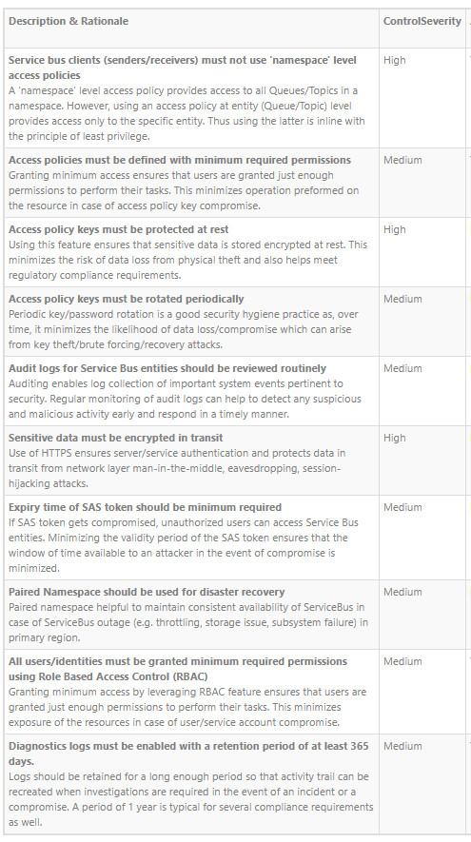
Security Controls: Service Bus

Slide 21
Security Options at–Service Bus
Network – Supports VNet service endpoints and Network isolation and firewalling support
Identity
Authentication – via Managed Identity using Azure Active Directory
Authorization – supports via RBAC and SAS token
Data Protection
Server-side encryption at rest: Microsoft-managed keys and BYOK
Encryption in transit (such as ExpressRoute encryption, in VNet encryption, and VNet-VNet encryption)
API calls encrypted

Slide 22
Azure Security Centre
Strengthen security posture: Security Center assesses your environment and enables you to understand the status of your resources, and whether they are secure.
Protect against threats: Security Center assesses your workloads and raises threat prevention recommendations and security alerts.
Get secure faster: In Security Center, everything is done in cloud speed. Because it is natively integrated, deployment of Security Center is easy, providing you with auto provisioning and protection with Azure services.

Slide 23



Reference material
https://docs.microsoft.com/en-us/azure/api-management/api-management-security-controls
https://docs.microsoft.com/en-us/azure/architecture/reference-architectures/enterprise-integration/basic-enterprise-integration
https://azsk.azurewebsites.net/02-Secure-Development/ControlCoverage/README.html

